Slide 1
Learning Basic C#
Lesson 2: Creating a Console Application

Slide 2
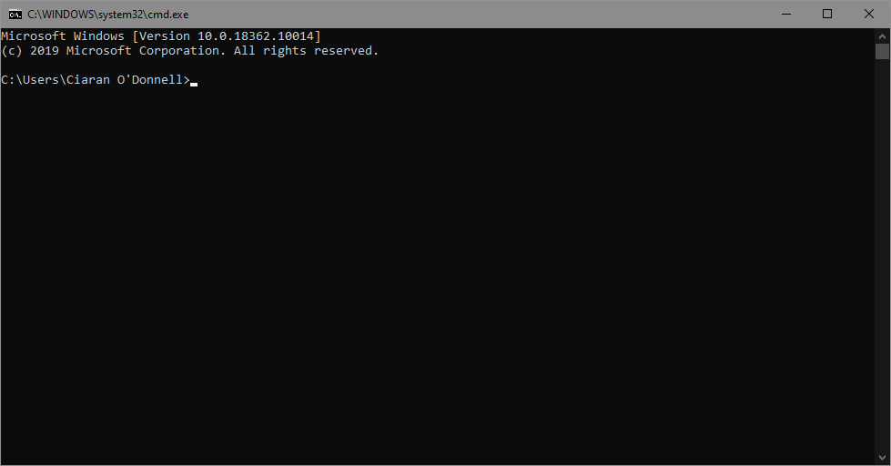
What’s a Console Application
The Console (or Terminal) is the weird black box type application that you used to see a lot more of in the early 90s
And you still see in movies when they want to illustrate hacking
It’s a basic text interface which existing before Graphical interfaces and people still like because you can create scripts that run them automatically

Slide 3
Why make one?
A Console / Command Line application can be very useful, and can be easy to make as you don’t have to make a GUI
Lots of developer tools are Command Line applications (CLIs)
They can be made quite powerful and very flexible, plus are easily made cross platform

Slide 4
But First…. Lets make a Repo
When we start something new, we might want to create a new repository to store our code, track changes, and back it up.
So lets get to github.com and sign in.
Then we can create a new repository, and we can clone it with the desktop application

Slide 5

Github Demo

Slide 6
Ok. Lets make our App
Lets open Visual Studio
We can create a new Console Application Project
We will create it in our cloned github repository
And we’ll ‘commit’ our code to git, and then ‘push’ it to github

Slide 7
Create Project Demo

Slide 9
CODE Tech

